Slide 1
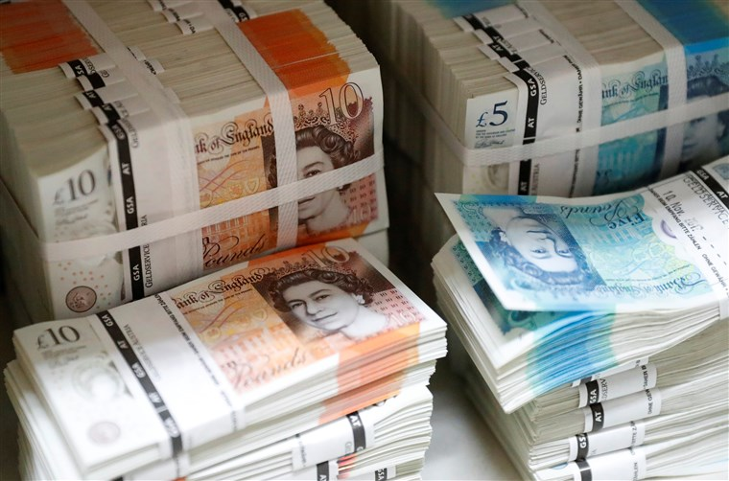
WHAT IS MONEY?

Slide 2
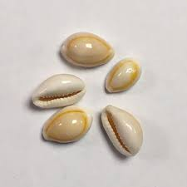
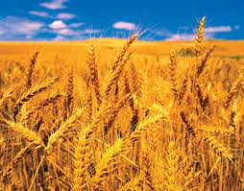
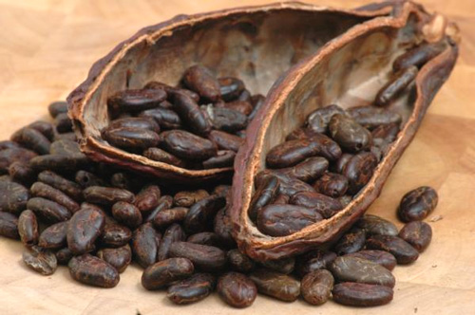
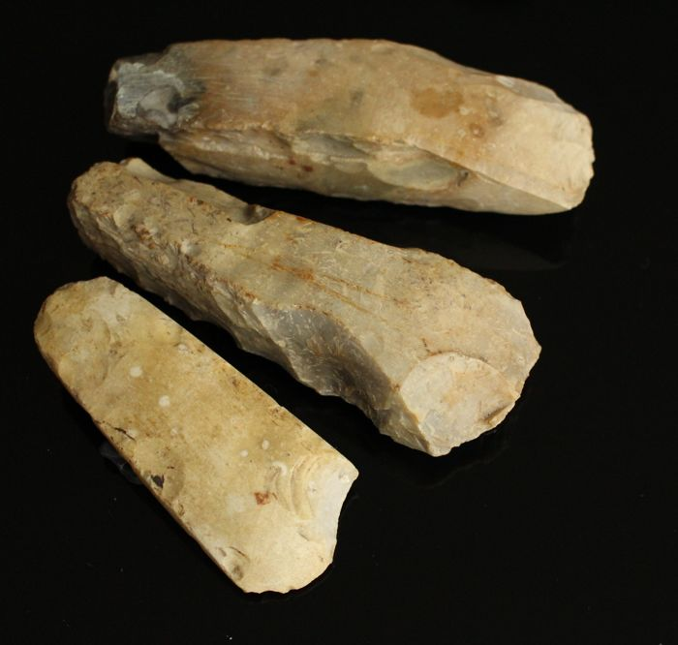
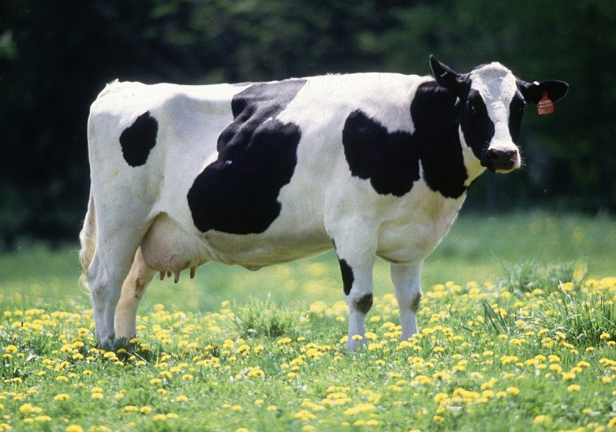
WHAT DO THESE OBJECTS HAVE IN COMMON?
THEY HAVE BEEN USED AS MEDIA OF EXCHANGE

Slide 3
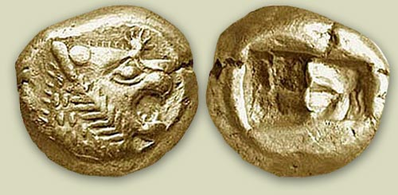
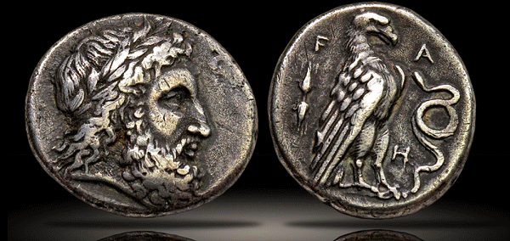
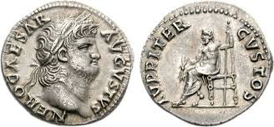
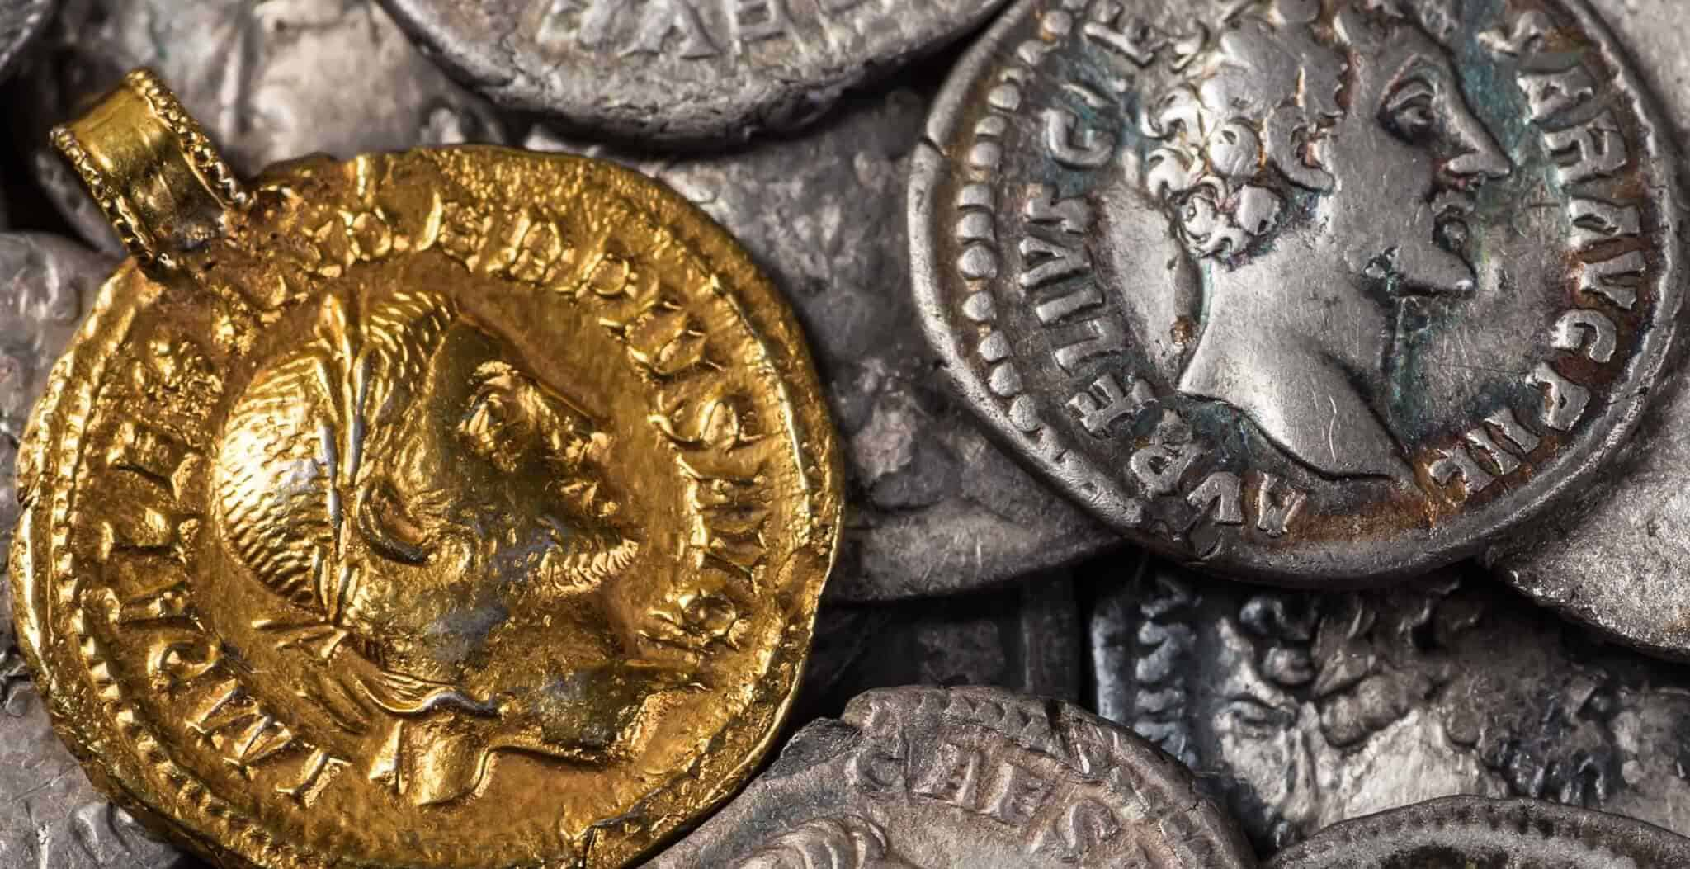
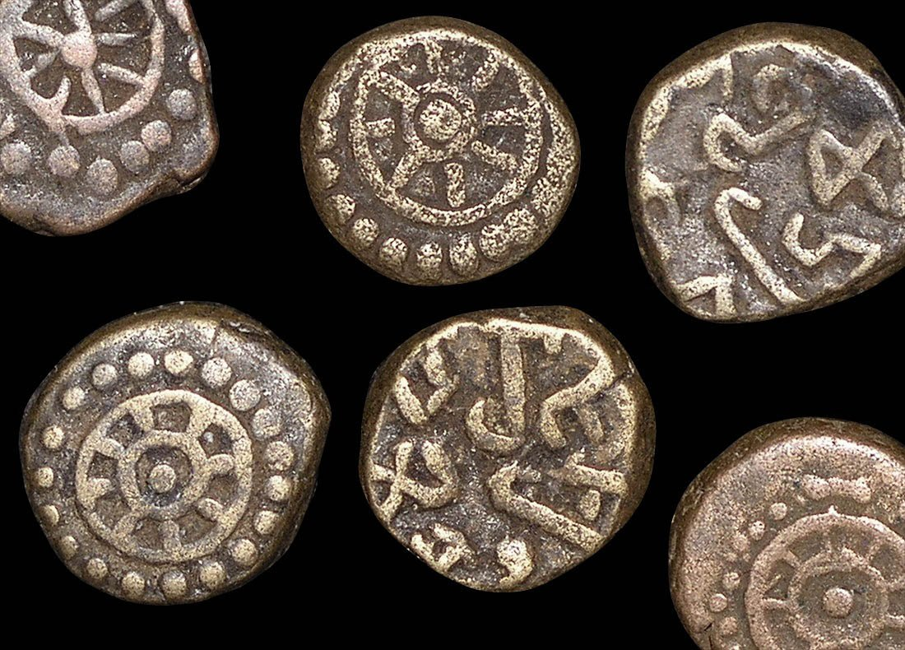
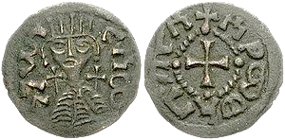
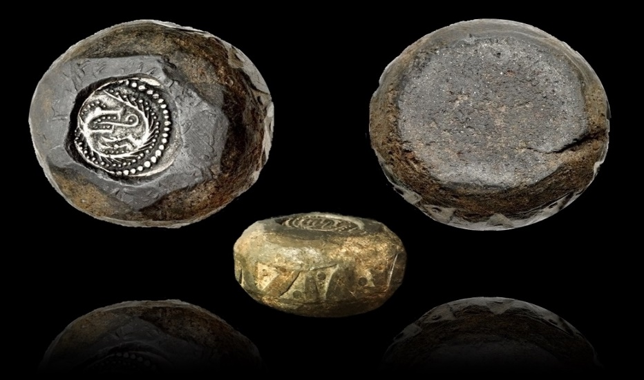
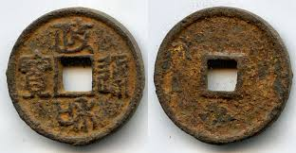
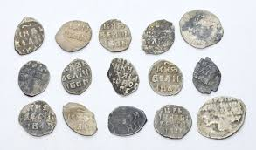
Lydia (present day Izmir), 600 BCE
Greece, 400 BCE
Rome, 10 CE
COINS AS MEDIA OF EXCHANGE
Roman Britain, 200 CE
India, 350 CE
Ethiopia, 900 CE
Viking Britain, 900 CE
China, 1100 CE
Russia, 1700 CE

Slide 4
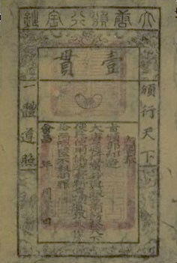
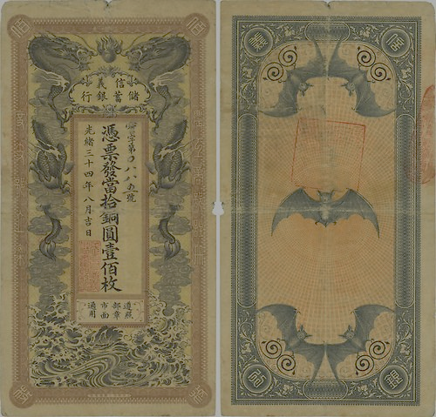
PAPER AS CURRENCY
CHINA IS WHERE MONEY ACQUIRED THREE MODERN FEATURES
PAPER (TANG DYNASTY, 600 CE)
STATE MONOPOLY (SONG DYNASTY, 1000 CE)
FIAT ISSUANCE (CHIN AND YUEN DYNASTIES, 1115-1368 CE)
BUT IT DID NOT LAST (OVER ISSUANCE)

Slide 5
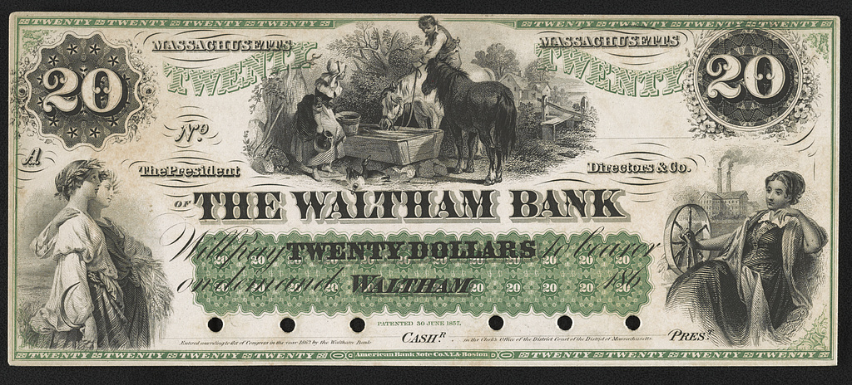
ITS NOT ISSUED BY A CENTRAL BANK
WHAT IS UNUSUAL ABOUT THIS $20 NOTE?

Slide 6
ALL ARE UNITS OF MEASUREMENT
days
Metres
seconds
$
minutes
radians
OUNCES
inches
Kg
Pounds
£
Feet
€uros
YEARS
Hours
degrees
WHAT DO THE ABOVE HAVE IN COMMON?

Slide 7
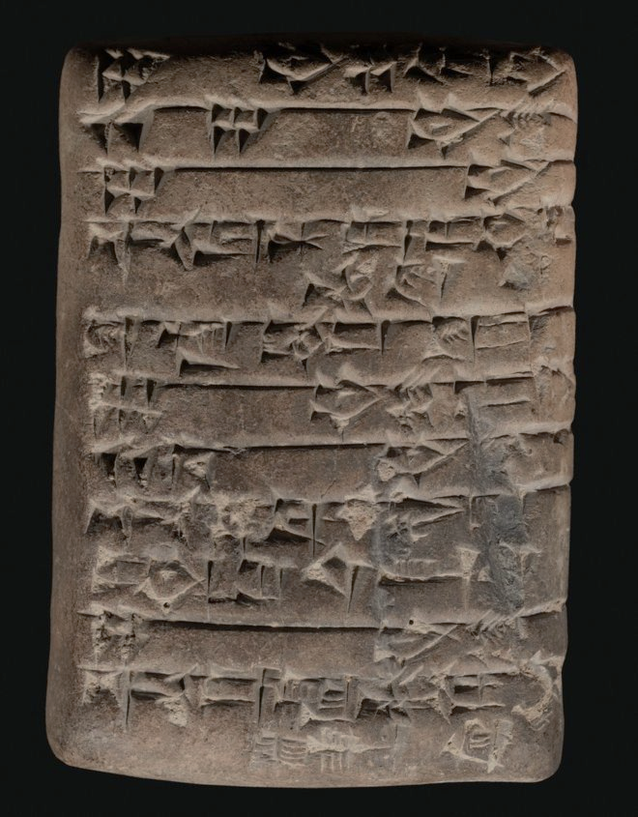
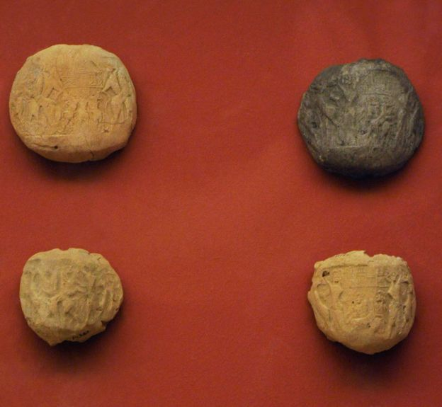
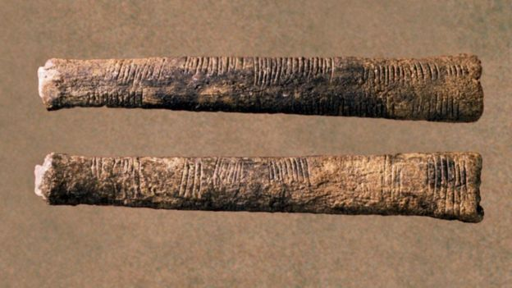
Mesopotamian Bulla
6000 BCE
Ancient Accounting Methods
Mesopotamian Cuneiform
Tablet, 3500 BCE
Congolese Tally Sticks, 18000 BCE

Slide 8
Gross national income at current prices (million GBP)
2018 | 2123051
2019 | 2231667
2020 | 2058523
2021 | 2299051
2022 | 2540238
2023 | 2698611
MONEY IS USED AS THE UNIT OF ACCOUNT
MODERN ACCOUNTING
WHAT IS THE BIG CHANGE?

Slide 9
WHAT DO THESE IMAGES HAVE IN COMMON?
ALL ARE FORMS OF ACCUMULATING WEALTH

Slide 10
WHAT SHALL YOU STUDY IN THIS MODULE?
A FORMAL ANALYSIS OF THE ROLE OF MONEY IN AN ECONOMY
HOW THE UNIT OF ACCOUNT ROLE LEADS TO THE MACROECONOMIC
CONCEPT OF THE “PRICE LEVEL” (WHICH IN TURN IS IMPORTANT FOR
UNDERSTANDING INFLATION).
HOW AND WHY MONETARISTS AND KEYNES DIFFER IN THEIR ANALYSIS
OF THE MACROECONOMIC EFFECTS OF MONETARY POLICY.
HOW MONEY’S ROLE AS A STORE OF VALUE LEADS TO THE POSSIBILITY
OF RECESSIONS.

Slide 11
WHAT SHALL YOU STUDY IN THIS MODULE?
BUT IN ITS OTHER TWO ROLES, IT LEADS TO A CAUSAL LINK
BETWEEN MONEY SUPPLY AND INFLATION.
HOW THIS INTERPLAY BETWEEN THESE TWO ROLES LED A CONSENSUS ON THE CONDUCT OF MONETARY POLICY.
7. THE EFFECTS OF 2008/9 AND SUBSEQUENT “SHOCKS” ON THE ABOVE.

